Slide 1
Beginner DP

Slide 2
What is DP (Dynamic Programming)
A problem-solving technique where you break a complex problem into overlapping subproblems and solve each subproblem only once, storing its result (usually in an array or table) to avoid repeated computation.
It’s often used for optimization problems (e.g., shortest path, maximum profit, minimum cost).
Example problems: Fibonacci numbers, Knapsack problem, Longest Common Subsequence, Matrix Chain Multiplication.

Slide 3
Properties of DP
Simple subproblems: Break the original problem into smaller subproblems with the same structure.
Optimal substructure: The best solution to the problem includes the best solutions to its subproblems.
Overlapping subproblems: Some subproblems are solved multiple times during the process.

Slide 4
Defining a DP Problem
State
Return Values
Base Case
Transitions
Memorizations

Slide 5
Frog1

Slide 6
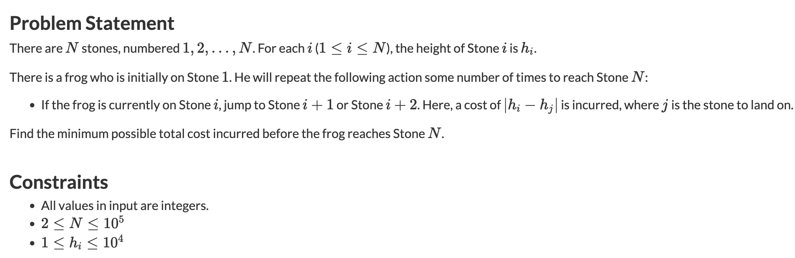
Frog1

Slide 7
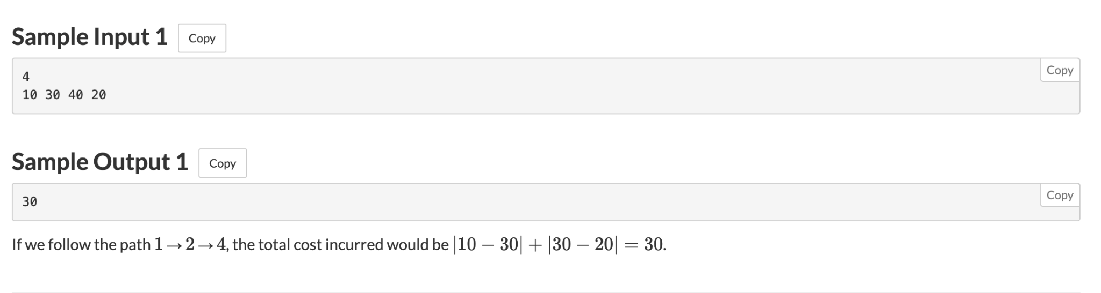
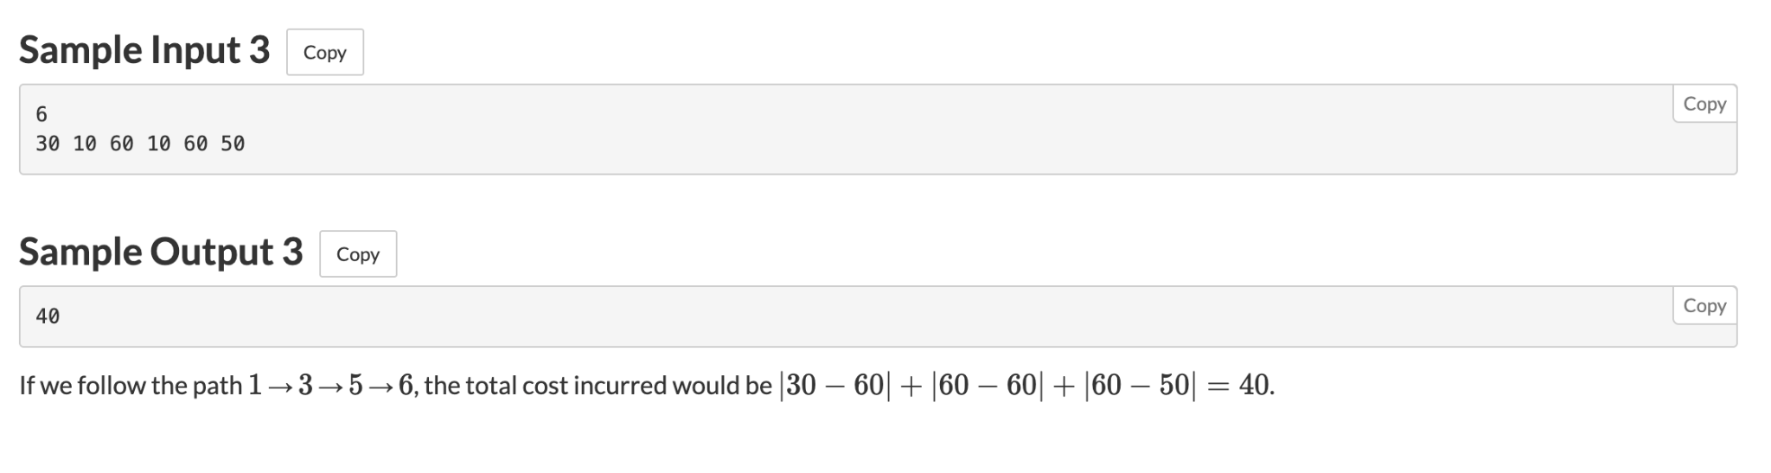

Slide 8
Knapsack 1

Slide 9
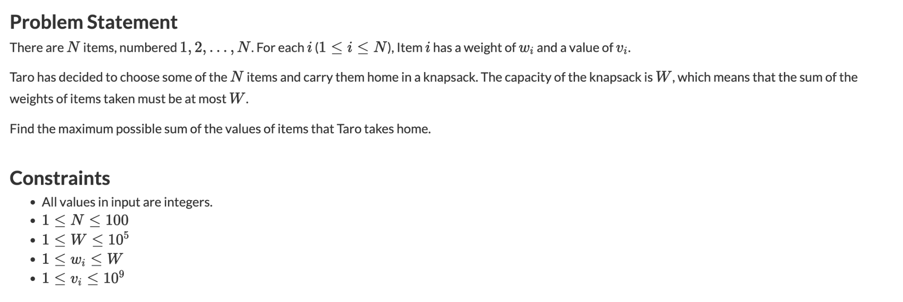

Slide 10
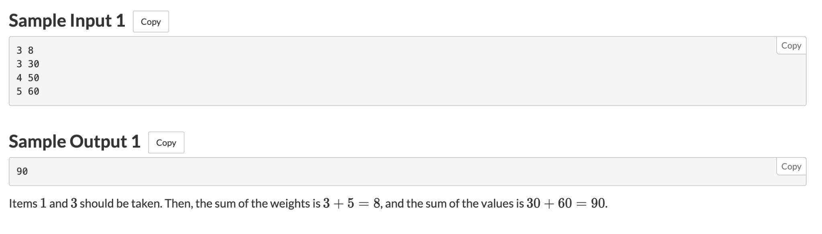

Slide 11
Knapsack 2

Slide 12
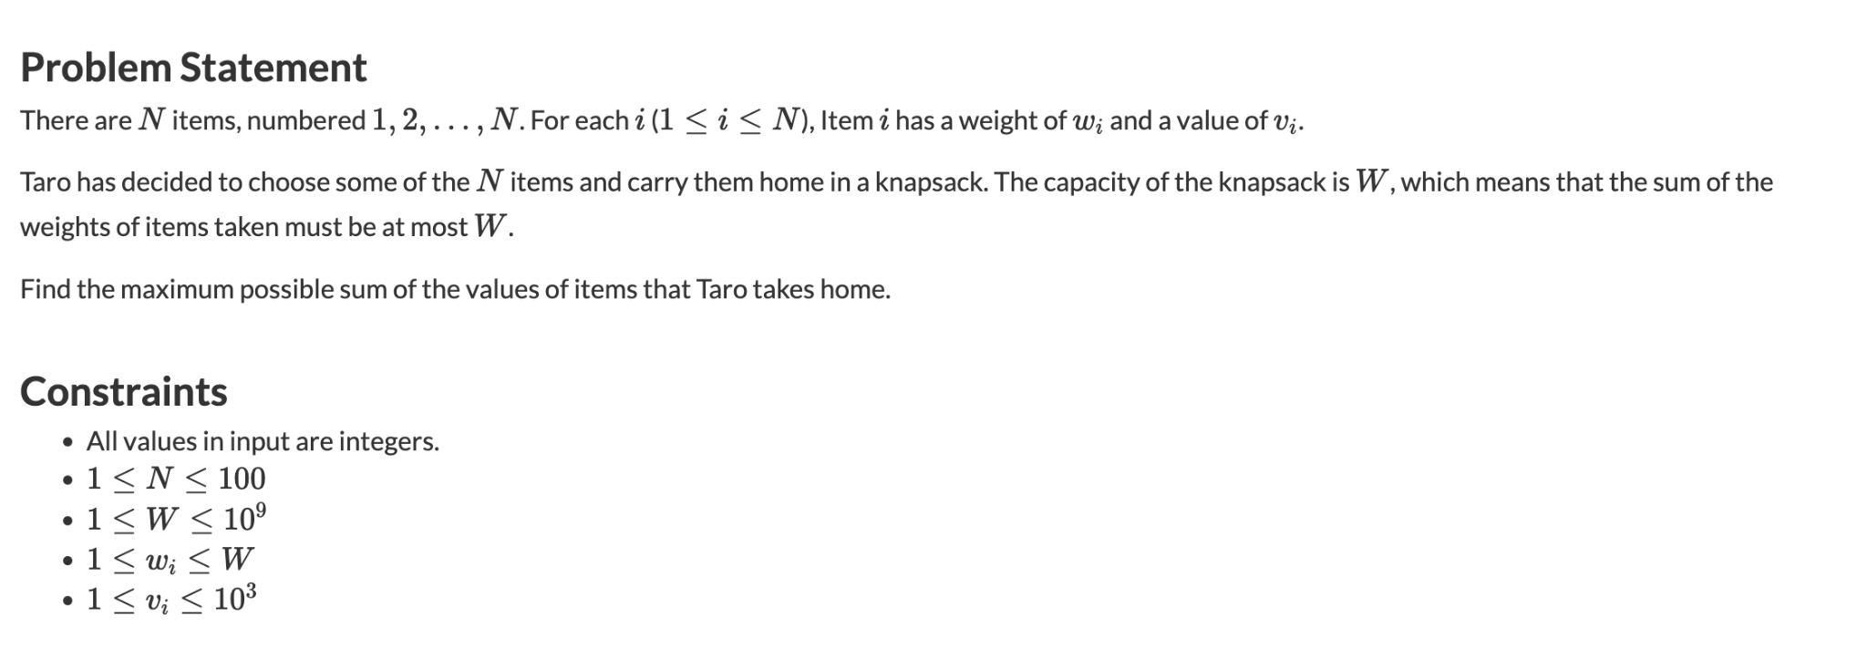

Slide 13
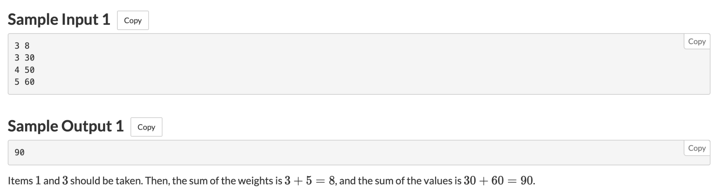
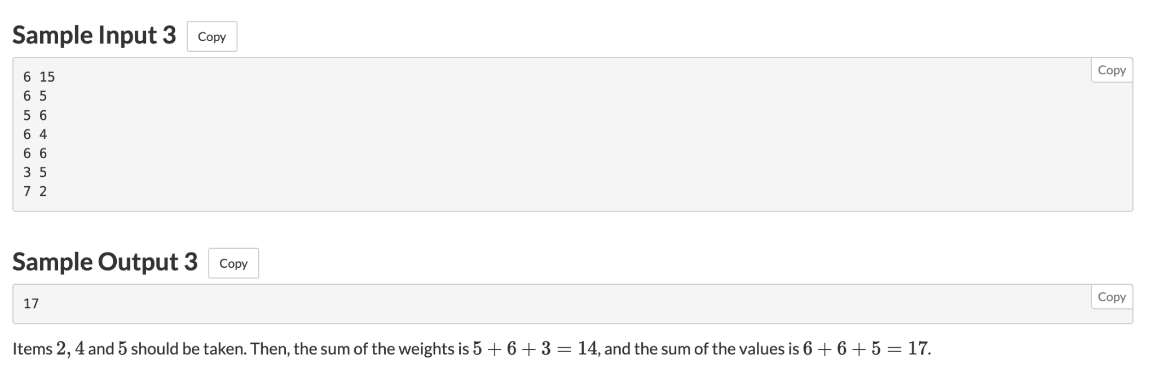

Slide 14
Edit Distance

Slide 15
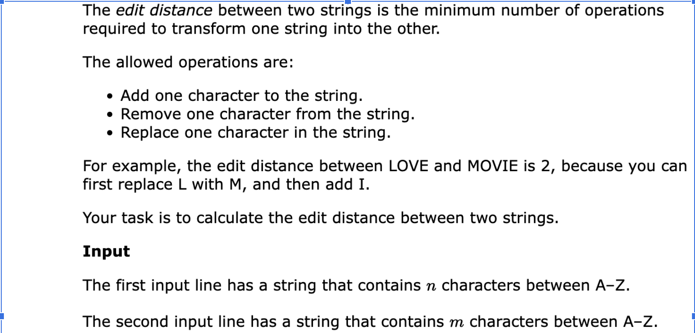
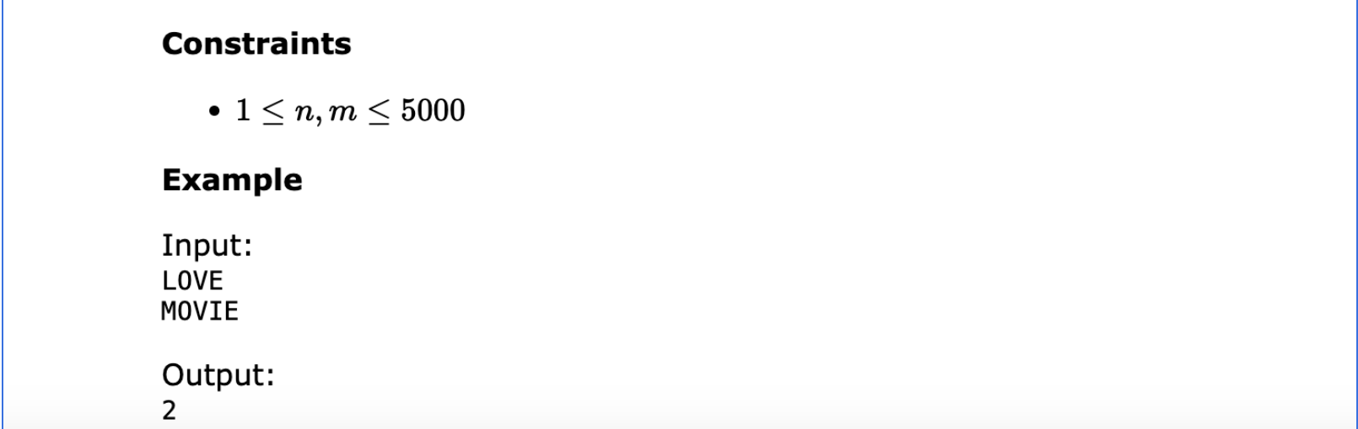

Slide 16
Longest Palindrome

Slide 17
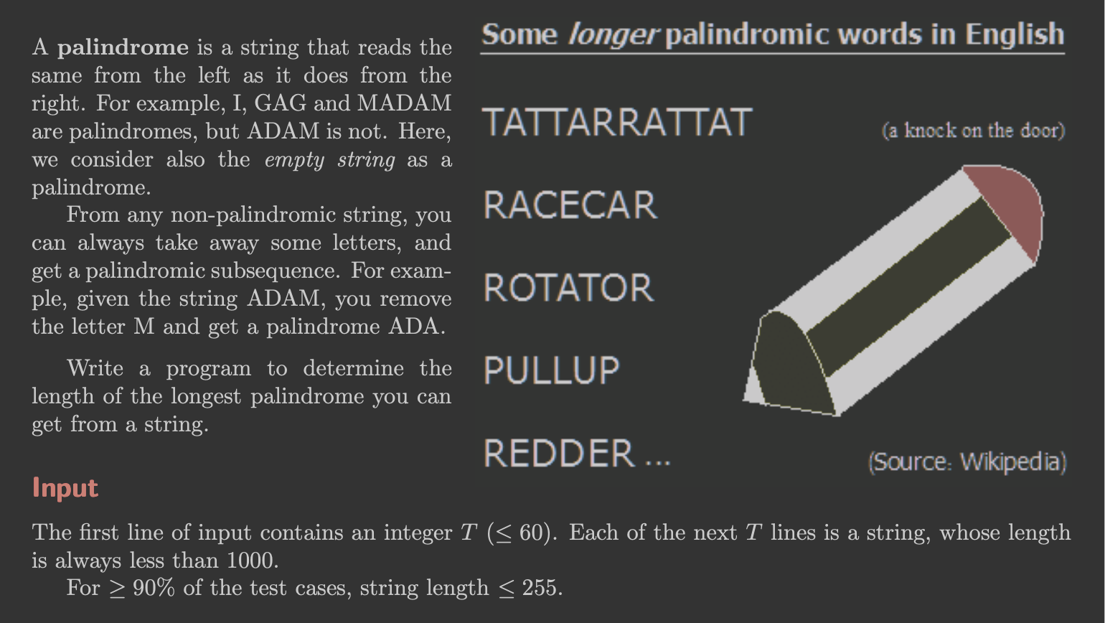

Slide 18
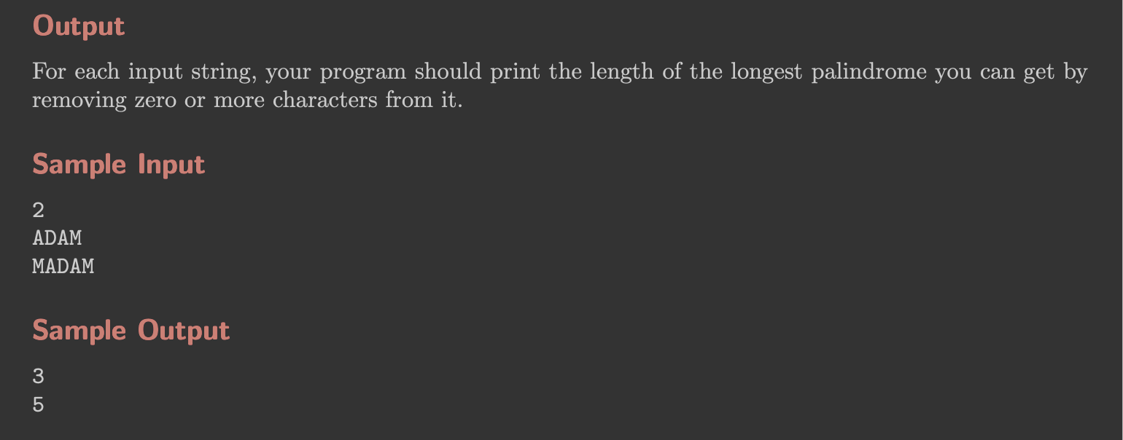

Slide 19
Longest Increasing Sequence

Slide 20
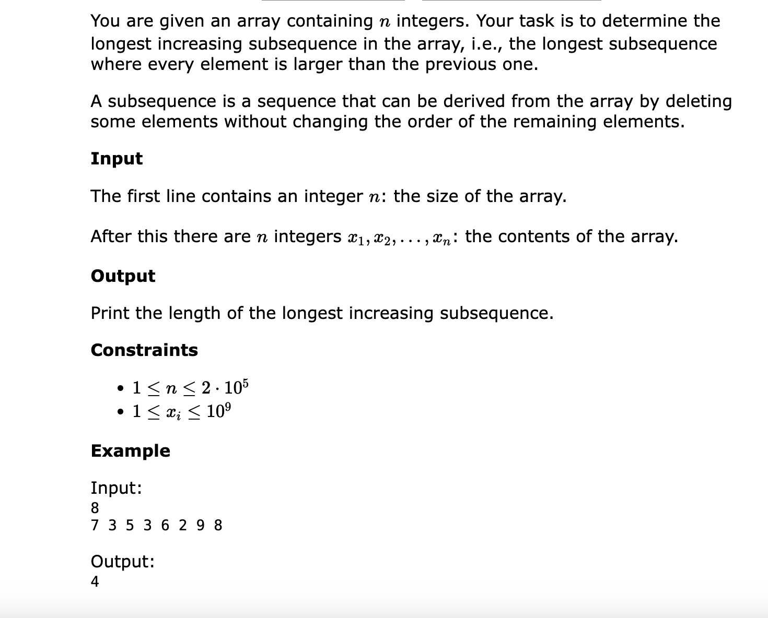

Slide 21
Matching

Slide 22
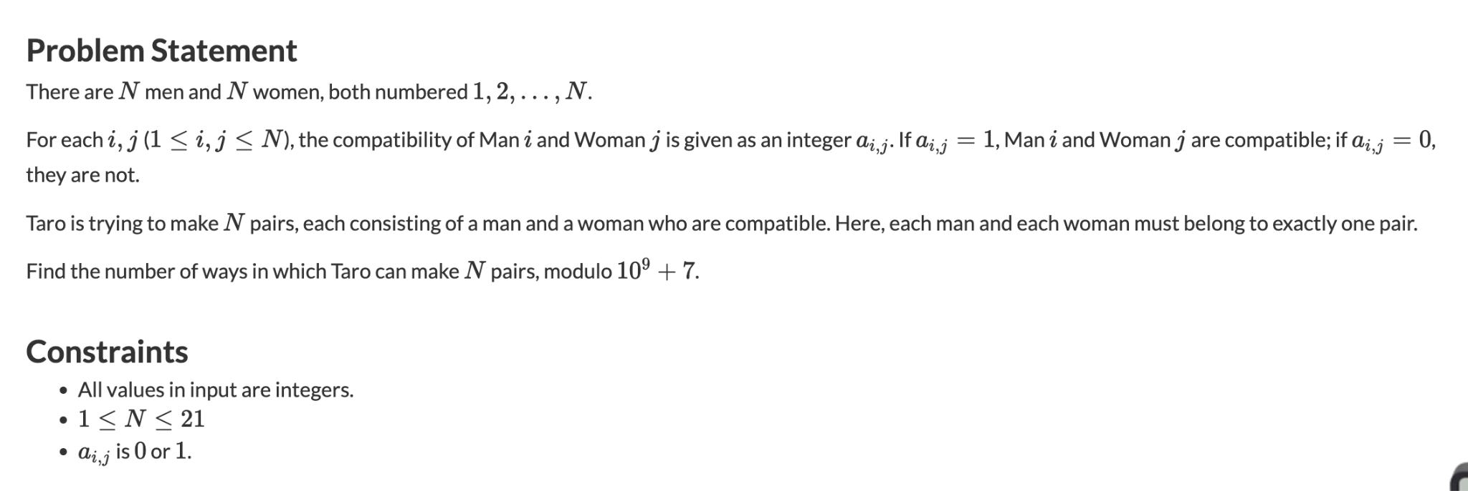

Slide 23
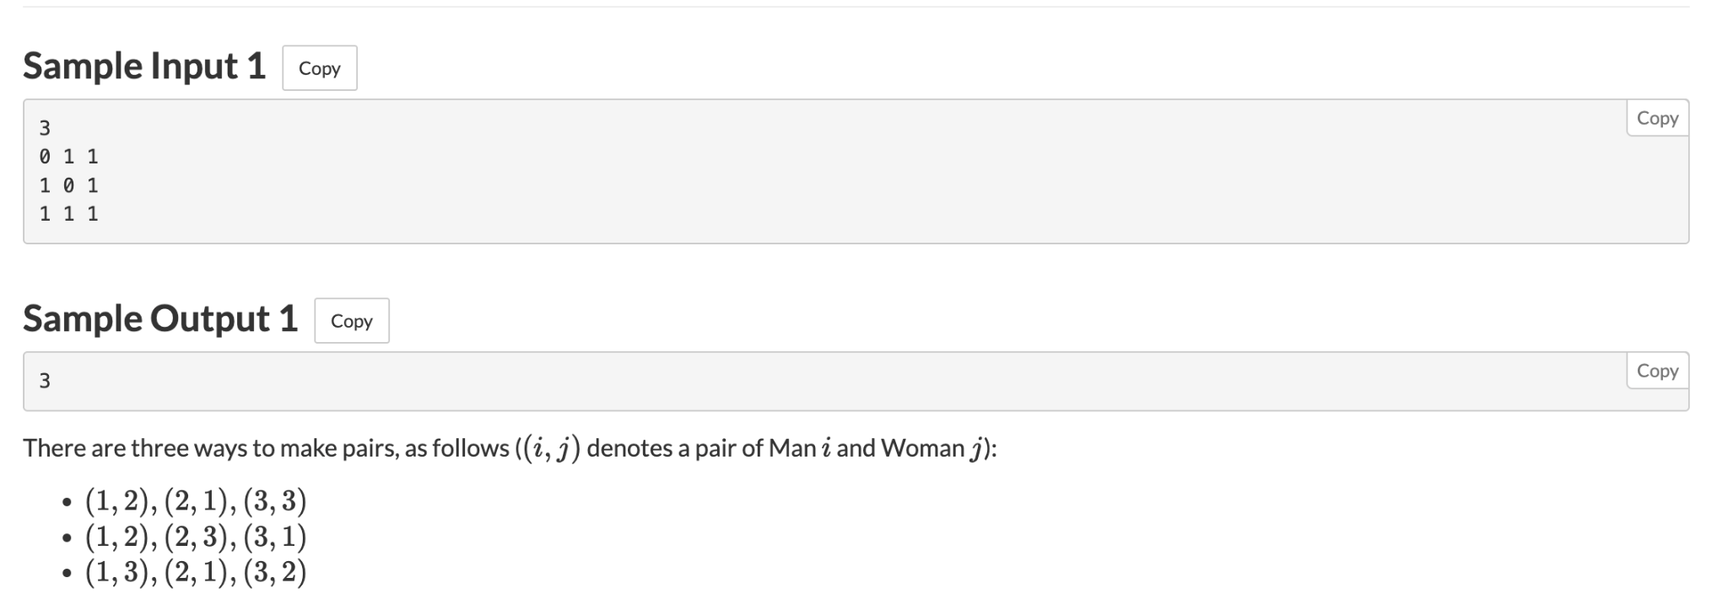
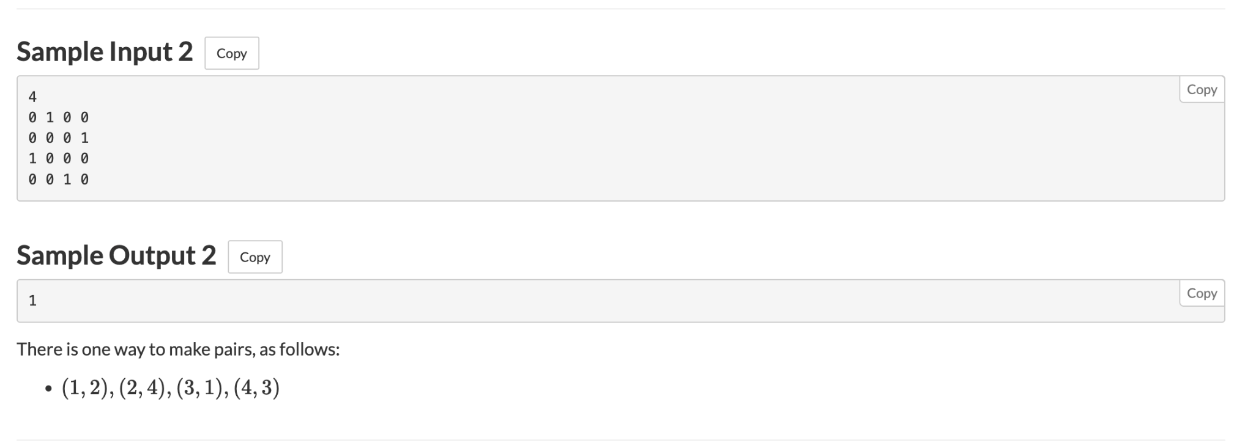

Slide 24
Grouping

Slide 25
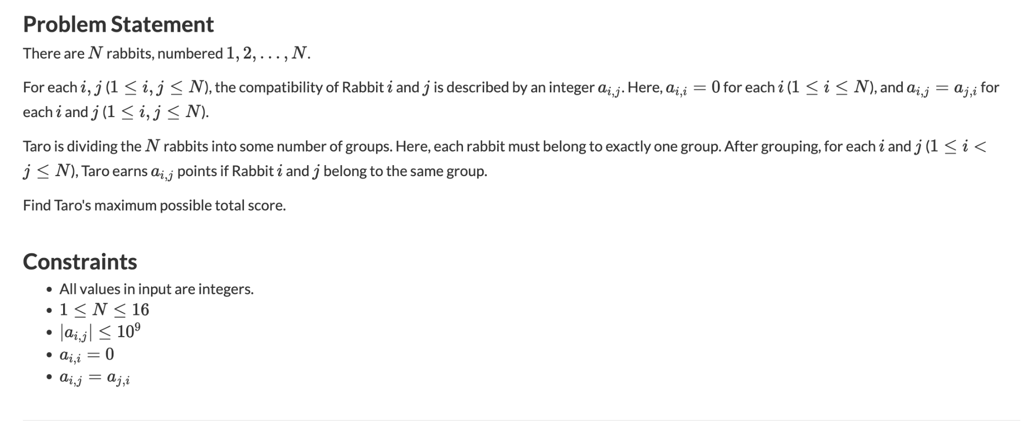

Slide 26
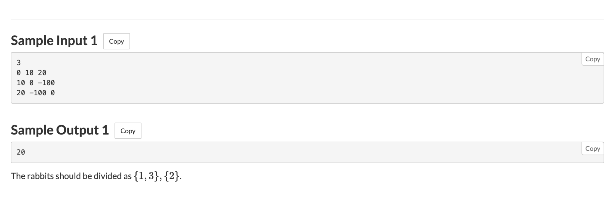

Slide 27
Thank You

